Slide 1


Welcome to
Python Programming
Training
ConsoleLancer LLP

Slide 2

Why Python ?
High-Package Salary in IT Sectors
2. Easy to Learn and Execute Complex Solution
3. Leading Language in Data Industry
4. Versatility and Career Advancement
5. Applications and Job Roles
6. Portability and Extensibility
7. Supports a Wide Range of Applications
Reference link : https://www.bestprogramminglanguagefor.me/why-learn-python
ConsoleLancer LLP

Slide 3

What Will You Learn?
From foundations to expert, learn about every major Python topic, working with Python 3.
Create games with Python, like Tic Tac Toe ,stone paper scissor !
Learn advanced Python features, like the collections module and how to work with timestamps !
Learn to use Object Oriented Programming with classes !
Understand complex topics, like decorators.
Understand how to use both the Jupyter Notebook and create .py files.
Get an understanding of how to create GUIs in the Jupyter Notebook system!
Automate extracting data from websites using web scraping libraries like BeautifulSoup and Selenium.
Build a complete understanding of Python from the ground up!
ConsoleLancer LLP

Slide 4
Topics Covered : -
Installing Python 3 ,
Installing Anaconda ,
Variables ,
Receiving Input ,
Type Conversion ,
Strings ,
Formatted Strings ,
String Methods ,
Arithmetic Operations ,
Operator Precedence ,
Math Functions ,
Logical and Comparison Operators ,
Weight Converter Program ,
Loops , Lists , Tuples , Dictionaries , Emoji Converter , Functions , Exceptions , Classes ,
Constructors , Inheritance , Modules , Packages , Pypi and Pip , web scraping ,
and many more
ConsoleLancer LLP

Slide 5
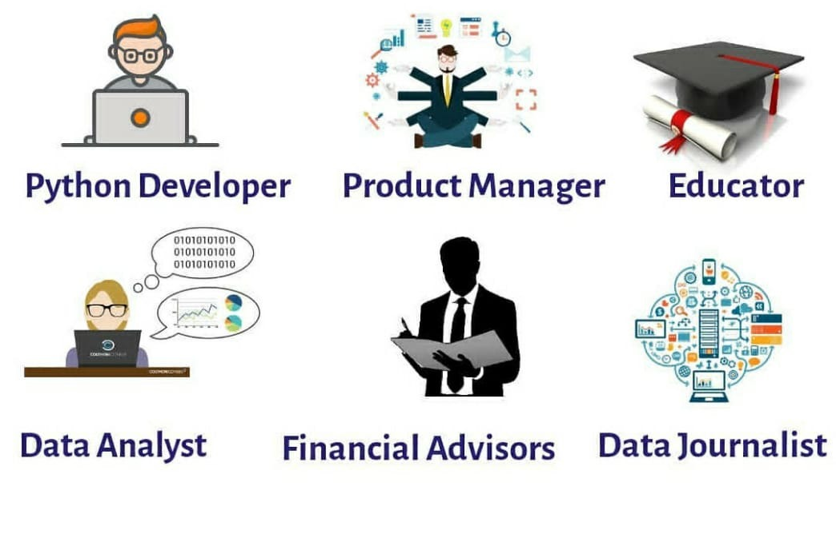
Jobs You can Land with Python Skills :
Source and reference link : https://learn.onemonth.com/6-jobs-you-can-land-if-you-learn-python/
ConsoleLancer LLP

